Slide 1
Presentation Title
<day> <month> <year>
<Presenter’s name, title, organisation>
Notes:
Image credits clockwise:
Anela Ramba - 528850160 / adobestock.com
DC Studio – 574566575 / adobestock.com
Gorodenkoff - 236237514 / adobestock.com
Jacob Lund - 187022751 / adobestock.com
sudok1 - 292021510 / adobestock.com
Gorodenkoff - 402341966 / adobestock.com
Kay A - 566595863 / adobestock.com

Slide 2




Acknowledgement of Country
We acknowledge and celebrate the First Australians on whose traditional lands we meet, and we pay our respect to their elders past and present.
Notes:
ACKNOWLEDGEMENT OF COUNTRY
I would like to acknowledge the Traditional Owners of the lands on which we meet today (include the name of the people) and pay my respect to their elders past and present.
Image credits clockwise:
federico-Garcia - MQxP65uEfJE / unsplash.com
ake1150 - 220246410 / adobestock.com
Tristan McKenzie - 715v3NOlVhU/ unsplash.com
René Riegal - 0VFr6ub7HlA / unsplash.com

Slide 3
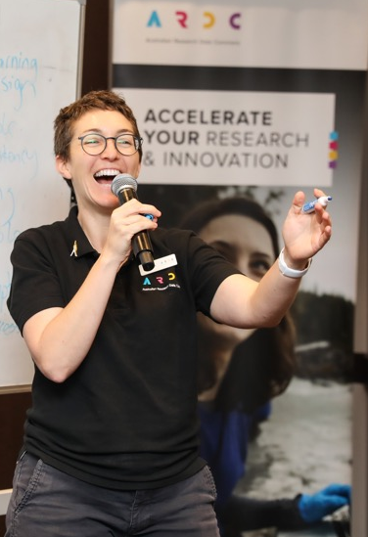
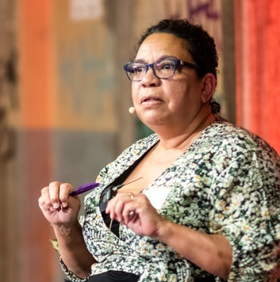
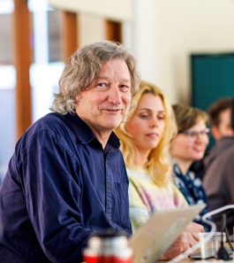
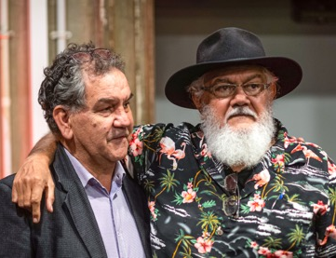
About the ARDC
The ARDC is Australia’s leading research data infrastructure facility.
Purpose
To provide Australian researchers with competitive advantage through data.
Mission
To accelerate research and innovation by driving excellence in the creation, analysis and retention of high‑quality data assets.
Notes:
ABOUT THE ARDC
The ARDC is Australia’s leading research data infrastructure facility.
The ARDC is enabled by the Australian Government’s National Collaborative Research Infrastructure Strategy (NCRIS).
OUR PURPOSE is to provide Australian researchers with competitive advantage through data.
OUR MISSION is to accelerate research and innovation by driving excellence in the creation, analysis and retention of high‐quality data assets.
Images Clockwise
Liz Stokes, ARDC, presenting at the ARDC Skills Summit - Renee Nowytarger / ARDC
Grant Sarra, facilitator, and Uncle Michael Williams, former head of the Aboriginal and Torres Strait Islander Studies unit at The University of Queensland, at the event, Bringing Data to Life: Co-Designing a Language Data Commons - Marc Grimwade / ARDC
Dr Paul Coddington and Darcelle Malby, ARDC, with partners from the ARDC Nectar Research Cloud nodes - Marc Grimwade /ARDC
Associate Professor Sandra Philips, Western Sydney University, at the event, Bringing Data to Life: Co‑Designing a Language Data Commons - Marc Grimwade / ARDC

Slide 4

PEOPLE
Research Data Commons
National-scale data infrastructure for health research and research translation
Notes:
PEOPLE RESEARCH DATA COMMONS
The ARDC People Research Data Commons (People RDC) is delivering national-scale data infrastructure for health research and translation.
Researchers, innovators and policymakers seek to improve health outcomes for society, which requires data and digital platforms that span multiple layers of government, health service operations, health research studies, institutes, facilities and the private sector.
https://ardc.edu.au/collaborations/strategic-activities/people-research-data-commons/
Image credit
Gorodenkoff - 236237514 / adobestock.com

Slide 5

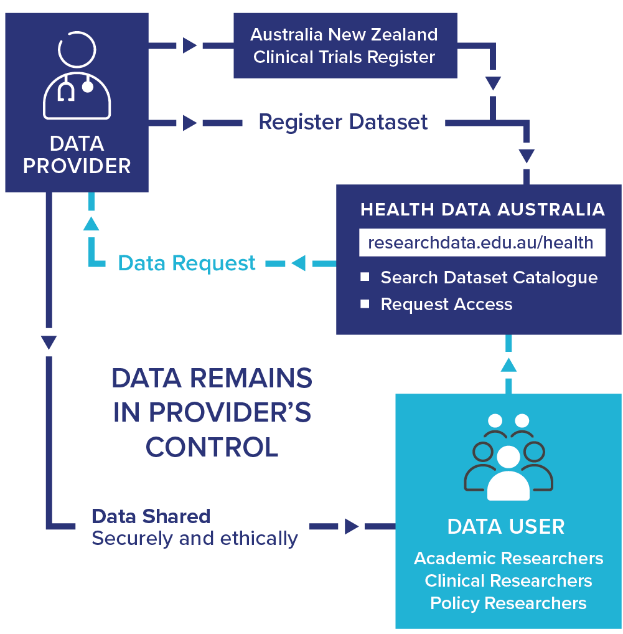
HeSANDA
Health Studies Australian National Data Asset
Health Data Australia
Discover and request clinical trial data from around Australia
Visit
researchdata.edu.au/health ▶︎
Notes:
EXAMPLE: Health Studies Australian National Data Asset (HeSANDA)
The People RDC builds on our experience creating national digital research infrastructure for health and medical researchers.
One example is, HeSANDA, our Health Studies National Data Asset, which is a national research infrastructure that is enabling researchers to share, access and reuse health research data to increase research impact and integrity.
The first phase of HeSANDA has worked alongside the health research community to support the sharing of clinical trials data.
The program includes 91 collaborators from 72 organisations, including 18 universities, 10 medical research institutes, 19 health service operators and 16 clinical trials networks.
Potential Benefits of HeSANDA include:
Collaboration
New health and medical research
Reduce costs, duplication, saves time
Extends the life of initial research
Contributes to data integrity
The next phase of the program has started already to expand the coverage beyond clinical trials data to data from observational studies such as cohort studies, and will integrate technologies to enable secure analysis of data.
https://ardc.edu.au/program/health-studies-australian-national-data-asset/

Slide 6








HeSANDA Advisory Committee
Notes:
From the outset, the HeSANDA program
Has been guided by a committee of peak national bodies
We have significant representation:
Including government, clinical trials networks, health translation researchers, and health consumers

Slide 7
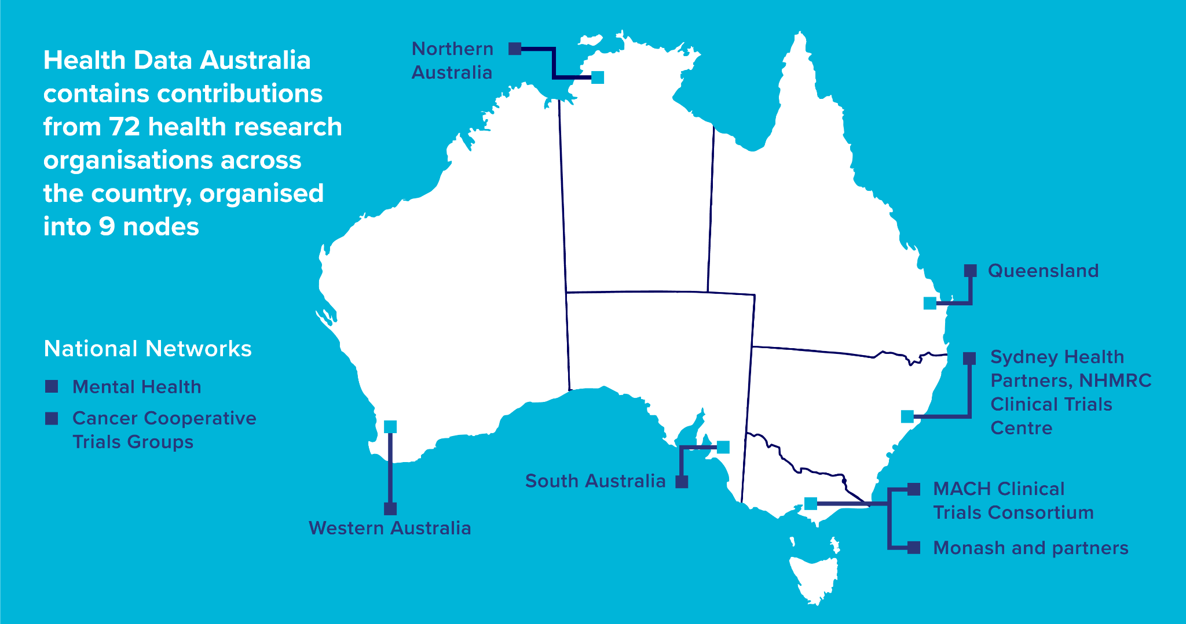
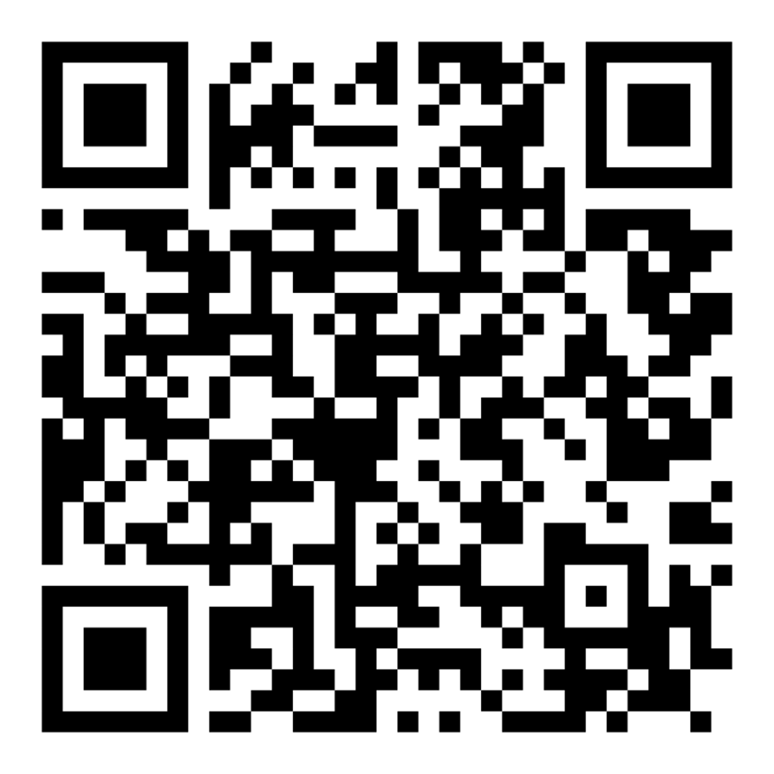
Scan QR code for more information & HeSANDA node contact details.
Notes:
72 organisations are leading the way and have created a national data sharing infrastructure network for Australia.
They’re grouped into 9 nodes:
7 of our nodes provide regional coverage in most states and territories
And the other 2 nodes have specialisations - 1 in cancer trials - and 1 in mental health trials
We’re working together as a national community of trials to agree on those standards.
And then each Node is working with their partners to implement the standards in a way that works best for their organisations.

Slide 8
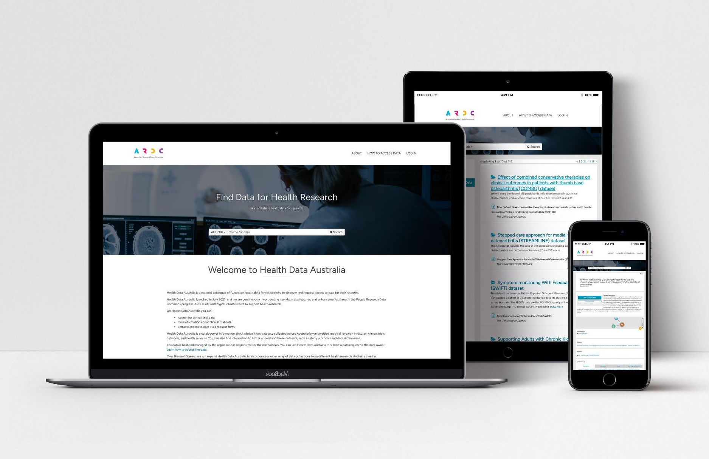
Health Data Australia
Make data sharing a standard practice for clinical trials in Australia.
Working collectively with peak national bodies to influence:
Policy
Procedures
Systems
Culture
visit - researchdata.edu.au/health ▶︎
Notes:
HEALTH DATA AUSTRALIA
A major output from HeSANDA was the delivery of a national catalogue of Australian health data called Health Data Australia.
On the Health Data Australia website, health and medical researchers can register a description of their research so it’s easy to discover.
The service is currently available for clinical trial data and will be expanded with other data types, including government and cohort data.
Researchers seeking data can discover and request clinical trial data from around Australia.
205 datasets in Health Data Australia in the first year.
72 organisations participating in Health Data Australia across 9 nodes.
Access Health Data Australia at researchdata.edu.au/health/

Slide 9

Notes:
What is Health Data Australia (Video)
Video Instructions (1 min 52 secs):
If you are sharing online, please make sure that you have also selected to ‘Share Sound’ in Zoom, Teams, etc
Open in ‘Slideshow’ (Top right corner)
Click on the rectangle on the slide, or the play button if it’s visable
If the video doesn’t work, then you can open it via YouTube (Note - this will take you out of google sheets, and there may be an Ad at the start)
https://www.youtube.com/watch?v=QyzVCjTtkMA

Slide 10
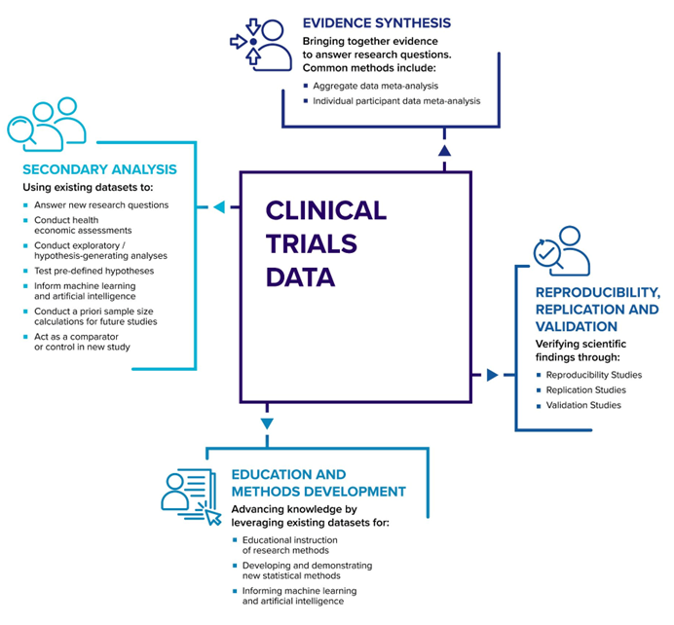
Why Share Data?
1. To improve the quality and productivity of your research
Extends the visibility
of your research
Opportunities for
new collaborations
Answer new questions, generate new hypotheses

Slide 11
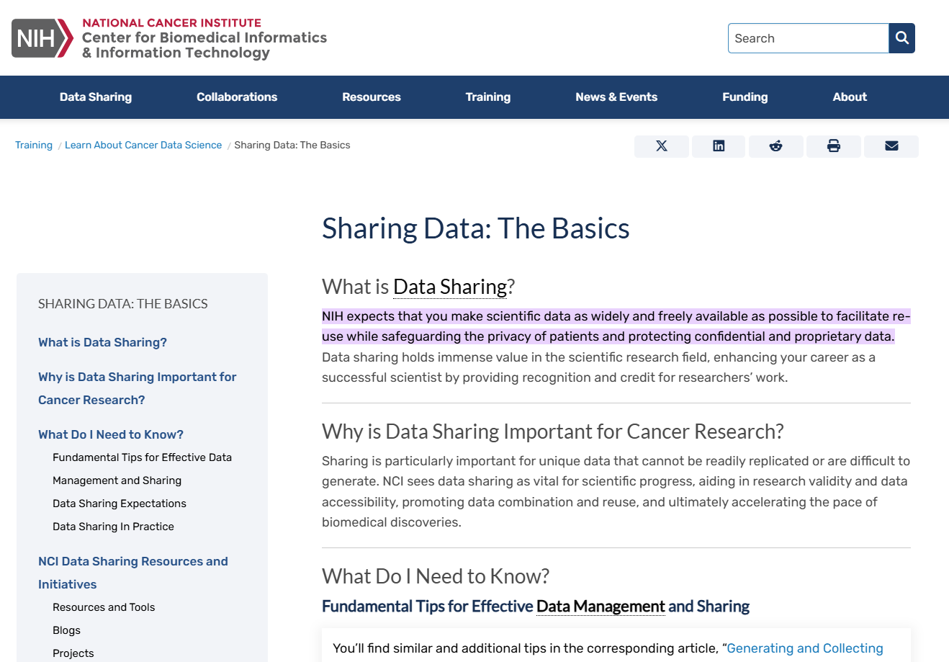
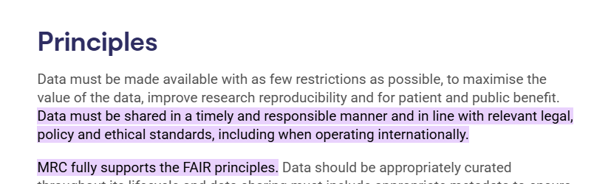
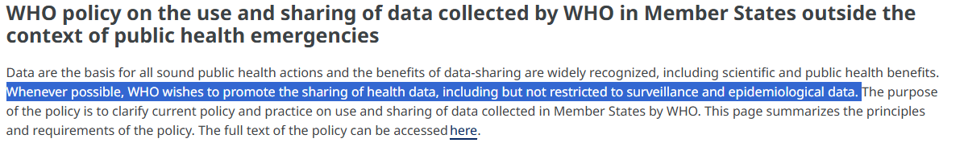
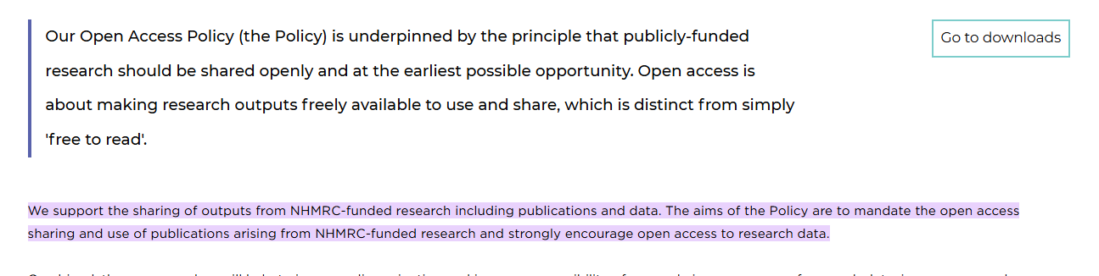
Why Share Data?
2. Encouraged for
publishing and funding
Funders & publishers around the world are pushing for it
Australian funding bodies are following suit
  NHMRC
  MRFF
Statements on Data sharing from NIH (US), MRC (UK), and WHO
Statements on Data sharing from NHMRC

Slide 12
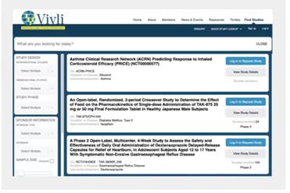
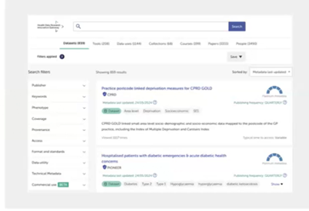
Why Share Data?
3. To be on par with the international data sharing research community
Clinical data sharing platforms exist globally, including:
  Vivli (USA)
  HDR UK (UK)
Health Data Australia (HDA) hosts Australian Clinical Trial meta data.
Vivli (USA) and HDR UK (UK) clinical trial sharing platforms

Slide 13
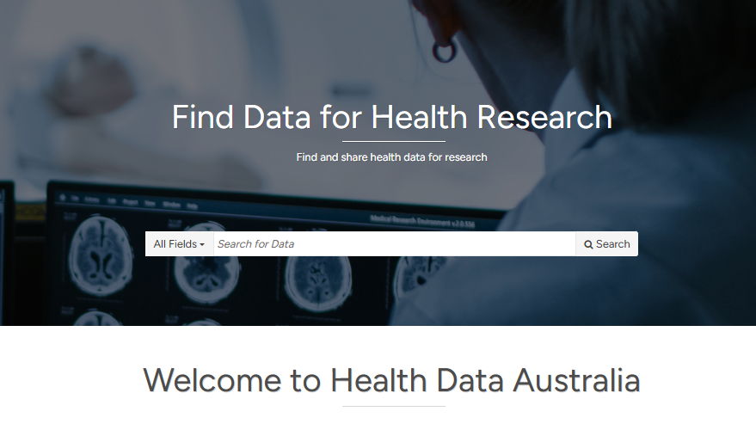
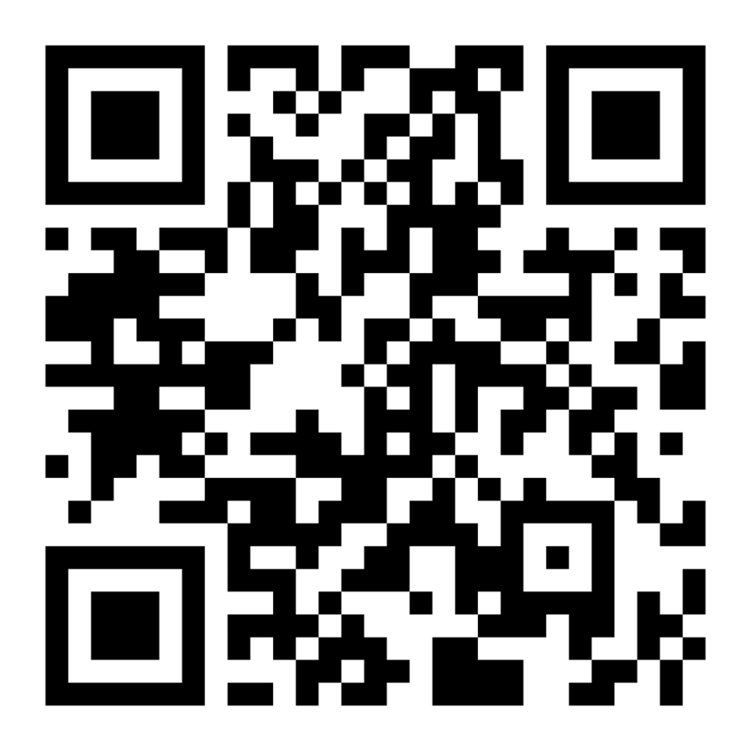
How to Contribute?
If your institute is a member
of a HeSANDA Node Network, you can contact the node directly (information in HDA).
If your institute is not affiliated, email contact@ardc.edu.au
researchdata.edu.au/health ▶︎

Slide 14
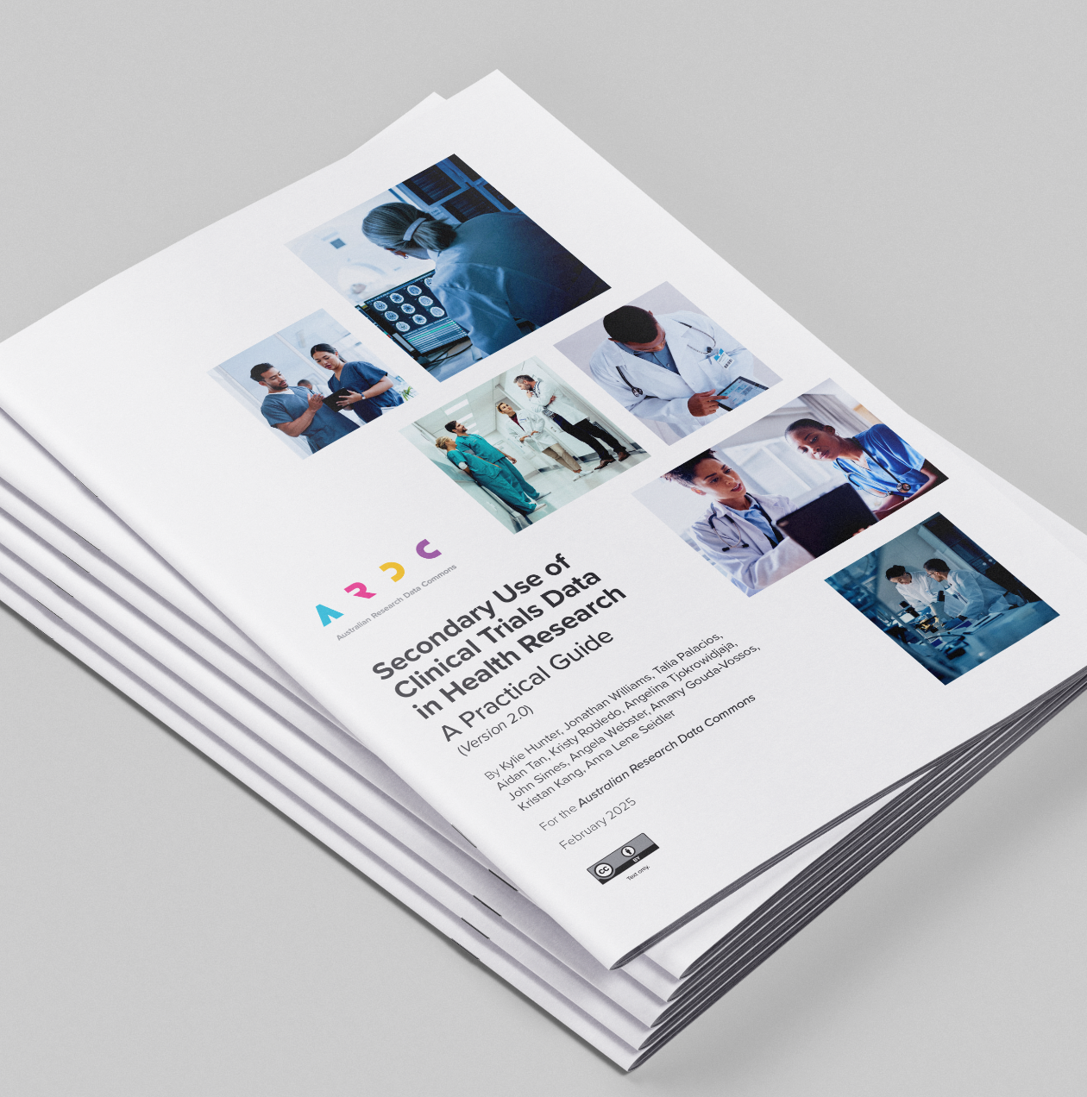
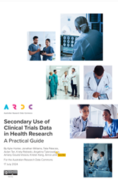
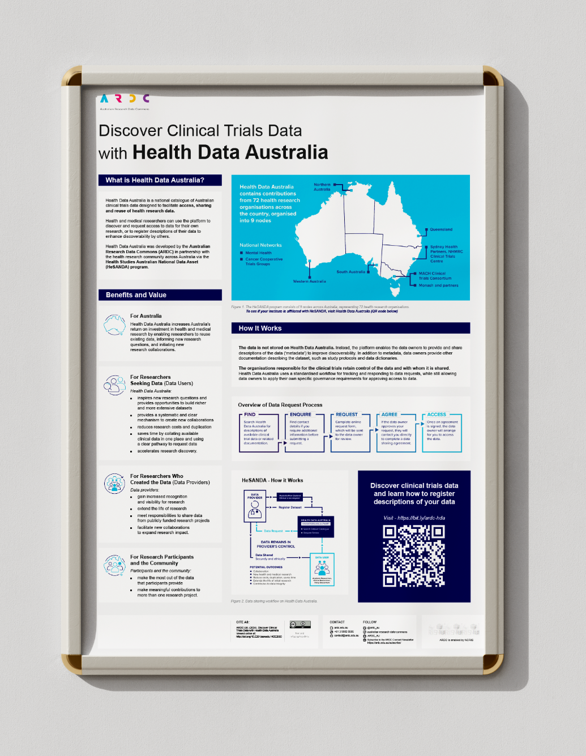
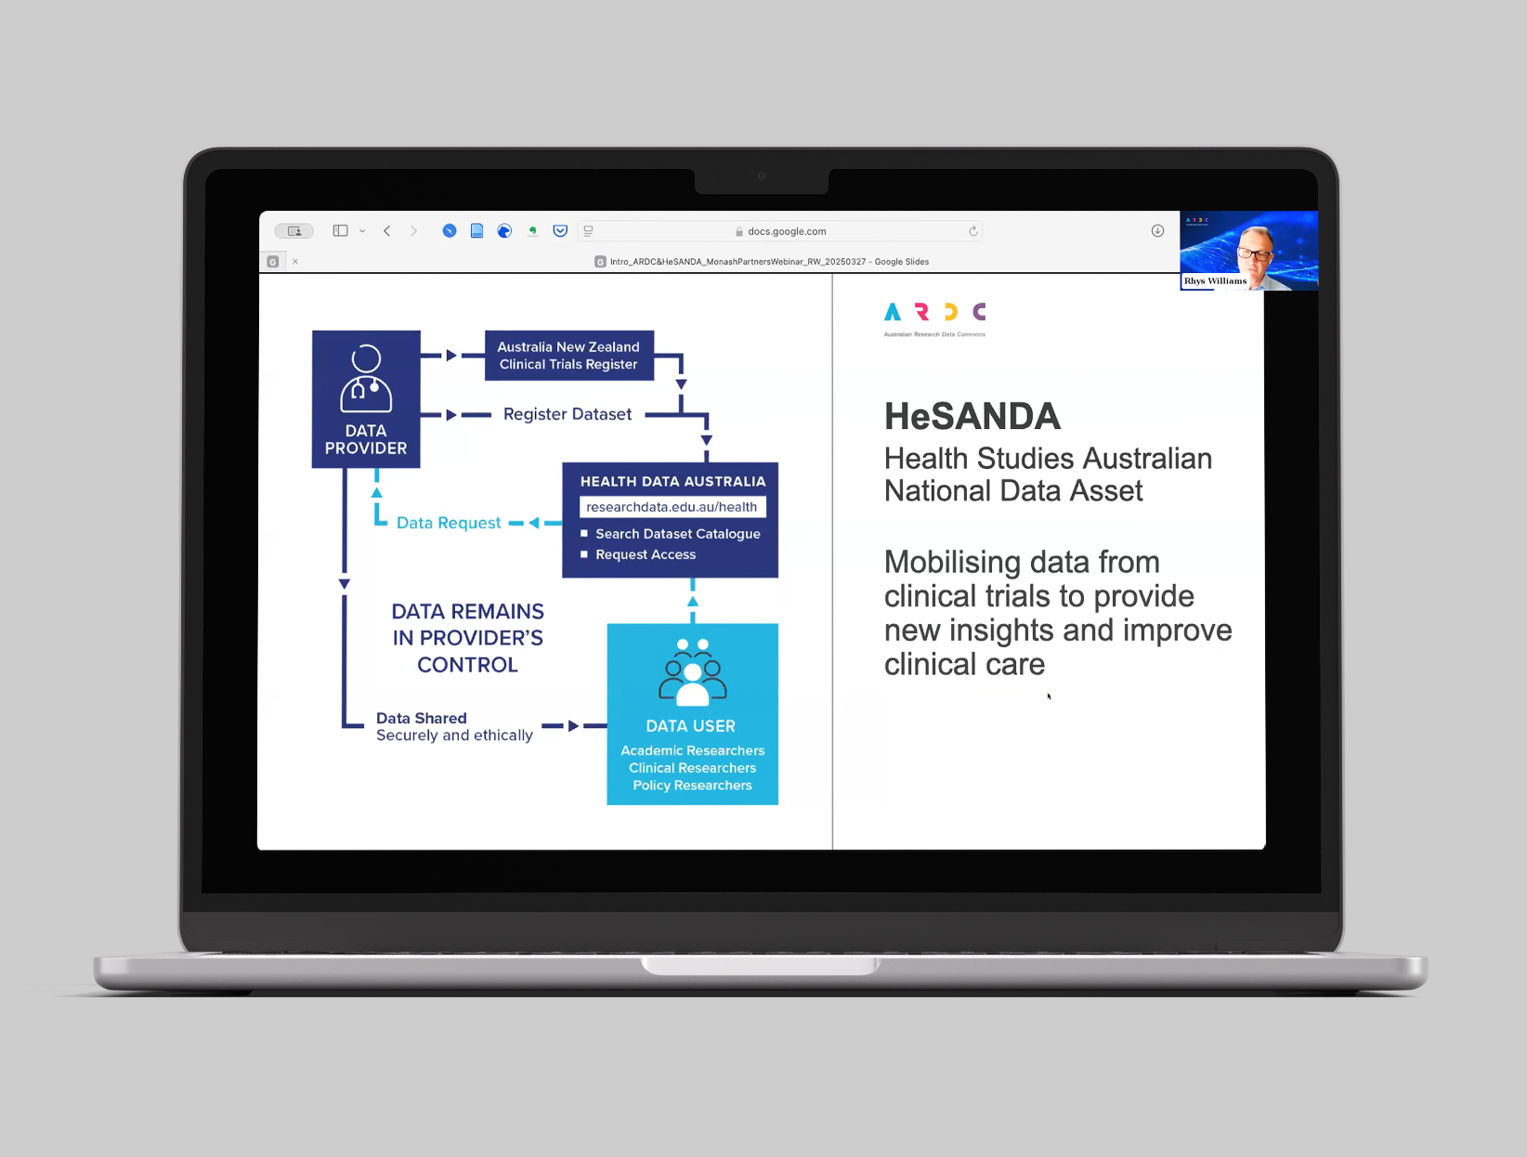
We Can Help!
Support
Consultation
Resources
Networking opportunities
Informative events

Slide 15

Contact Us
HeSANDA Management Team
Email us at - hesanda@ardc.edu.au ▶︎

Slide 16
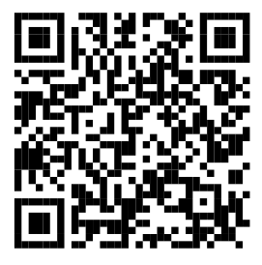
PEOPLE
Research Data Commons
National-scale data infrastructure for health research and research translation.
Find Resources for Researchers
Explore datasets, free tools and upskilling materials we’ve curated for data-intensive research in health research and research translation
Get Involved
Learn more about and register
your interest in the People
Research Data Commons.
Notes:
RESOURCES FOR HEALTH AND MEDICAL RESEARCHERS
The People RDC builds on the ARDC’s experience creating national digital research infrastructure for health and medical science researchers.
Find existing resources for researchers and get involved with the People RDC at https://bit.ly/ARDCPeople >
Image credit
Gorodenkoff - 236237514 / adobestock.com

Slide 17







CONTACT
ardc.edu.au
contact@ardc.edu.au
+61 3 9902 0585
@ARDC_AU
Australian-Research-Data-Commons
Subscribe
https://ardc.edu.au/subscribe
Notes:
THANK YOU
Finally, thank you for your time today.
Please visit our website if you would like to know more about what we do.
We are on LinkedIn and X, but the best way to keep up-to-date with everything in national research data management and software, including the latest news, resources, events and jobs, is to subscribe to our newsletter.

